Slide 1
QUANTIFYING MYOCARDIAL DAMAGE USING ECG SIGNAL
Biosignal Processing Project
Instructor: PhD. Trung Le
Student: Nguyen Pham

Slide 2
INDEX
Myocardial Infarction
Electrocardiogram signal
Project objectives
Design and Implementation
Result and Validation
Conclusion and Discussion
REFERENCE

Slide 3

I. Myocardial Infarction
Myocardial Infarction is the leading cause of death worldwide
The World Heart Federation (WHF) estimates that the incidence of CAD in Vietnam in 2017 may reach 20%, ranking 4th in the world
Disease caused by insufficiency of blood supply to the heart’s tissue
Symptoms: Severe chest pain, Vomit, dizziness, shortness of breath

Slide 4
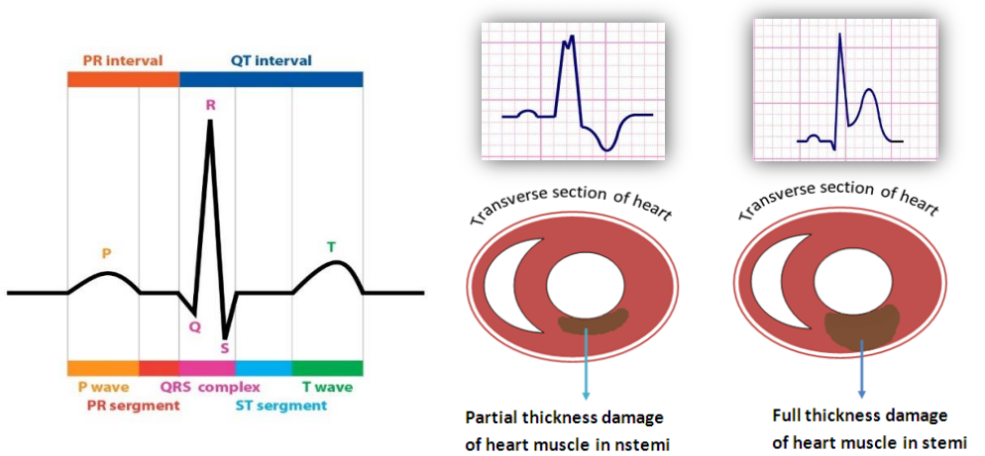
II. The electrocardiogram signal
Gold standard for approving patients to the Heart Disease Department
It measures the electrical activity of the heart during each consecutive heart beat
Detect MI: ST segment and T wave morphology

Slide 5
II. The electrocardiogram signal
Sources of noises:
Instrumentation noise
Electrode noise
Skin contact
EMG
Electric field from nearby devices

Slide 6

III. Project Objectives
Detection of ST Deviation (ST segment Elevation or Depression) in the ECG signal
Quantify the level of injury
Diagnose Myocardial Infarction for an ECG record

Slide 7
IV + V. Design and Implementation
Raw ECG signal
Normalization basing on energy
Baseline Wander Removal
Detrended Fluctuation Analysis
RR segmentation
QRS Detection
Estimating Threshold
Validation

Slide 8
RAW ECG
ECG data is taken from 3 Physionet Database:
Long-st Database:
recordings = [20011 20221 20271 20272 20273 20274 20461 20161 20361];
European Database:
recordings = [103 112 118 111 121 119 129 139 133 162 161 154];
ST-change Database
recordings = [300 302 303 306 317];
12 bit resolution
Record range from 2 hours to 22 hours
Sampling rate of 250 Hz
Contain 16 cases of MI, 10 cases of Normal

Slide 9
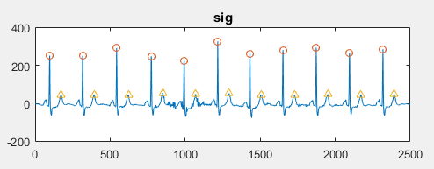
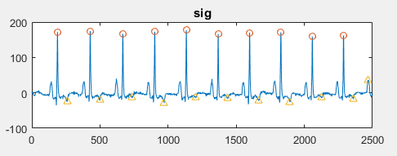
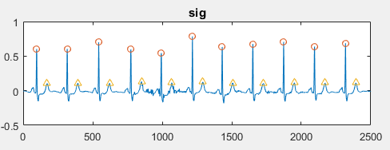
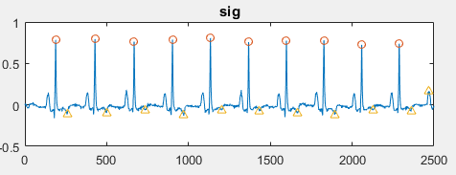
Normalization
% NORMALIZATION CODES---------------------
sig1_raw = sig1_raw - mean(sig1_raw);
L = length(sig1_raw);
Ex = 1/L * sum(abs(sig1_raw).^2);
sig1_raw = sig1_raw / Ex;
% NORMALIZA THE SIGNAL FROM 0 TO 1
sig1 = sig1 + abs(min(sig1));
sig1 = sig1 / max(sig1);
Scale down the signal with its energy
Purpose: make the signal comparable

Slide 10
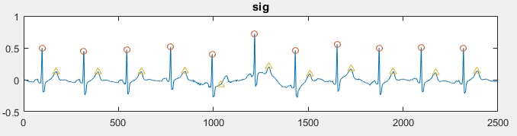
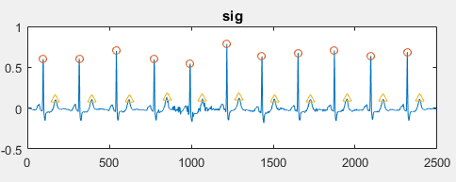
Baseline wander removal using Wavelet Transform
Using Discrete Wavelet Transform (DWT)
‘db4’ mother wavelet, 8 level of decomposition
The approximation at level 8 is the baseline wander
Before
% BASELINE REMOVE
[approx, detail] = wavelet_decompose(sig1_raw, 8, 'db4');
sig1 = sig1_raw - approx(:,8);
After

Slide 11
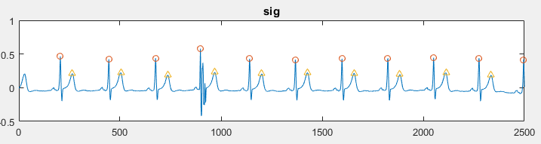
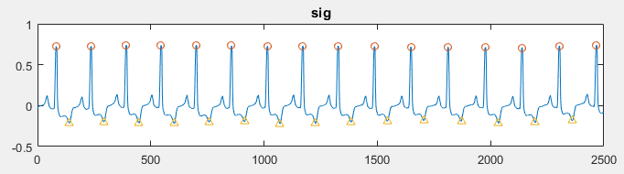
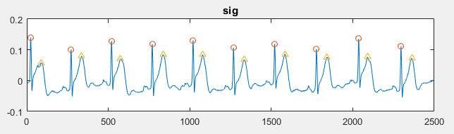
R peaks detection and T wave detection
Self – constructed algorithm for R peak and T wave Detection (33 lines of code)
Span is 10 seconds
Analysis is applied for each heart beat
Output is plotted as a graph and its mean value is provided

Slide 12
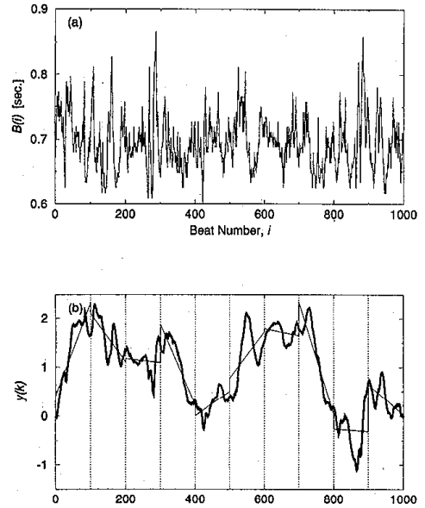
Detrended Fluctuation Analysis: an overview
Measures the degree of fluctuation within a signal without consider its trend
Large value of DFA corresponds to more complexity of a system
Many researchers have reported the relationship between DFA and MI
Normal subject: DFA < 1
MI subject: DFA > 1
Matlab supported code:
dfa = DetrendedFluctuation(data);

Slide 13
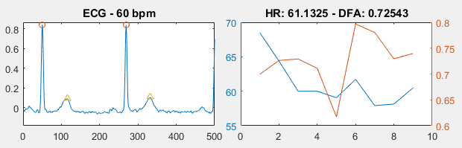
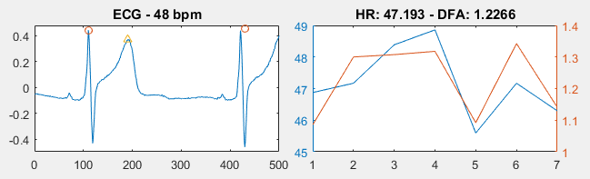
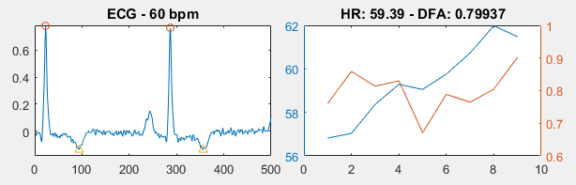
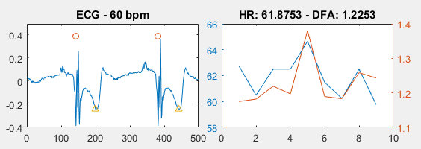
Validation
Normal patient
ST Elevation MI
T inverted Ischemia
ST Depression MI

Slide 14
Validation
Threshold: - DFA > 1: MI detected
- DFA < 1: No ST Deviation detected
Validation: - 7 records of transient ST Depression: 6 corrected
- 9 records of no transient ST Depression: 3 corrected
- 10 records of normal control: 8 corrected
Sensitivity: - 56%
Specificity: - 80%

Slide 15
VI. Conclusion and Discussion
In order to obtain good result using ECG, QRS detection need to be extremely precise
DFA is found to be valuable in detection of transient Myocardial Infarction
The higher the DFA, the more severe the ST Deviation, the more dangerous the case of MI
However, its ability to distinguish ST change MI with no transient ST change MI is still poor
More features should be extracted in order to reliably detect Myocardial Infarction using ECG sigal

Slide 16
VII. References
Woo MA, Stevenson WG, Moser DK, Trelease RB, Harper RH (1992) Patterns of beat-to-beat heart rate variability in advanced heart failure. Am Heart J 123:704–707
Wharton JM, Coleman RE, Strauss HC (1992) The role of the autonomic nervous system in sudden cardiac death. Trends Cardiovasc Med 2:65–71
Wilson PW, Evans JC (1993) Coronary artery prediction. Am J Hypertens 6:309S–313S
Rothschild M, Rothschild A, Pfeifer M (1988) Temporary decrease in cardiac parasympathetic tone after acute myocardial infarction. Am J Cardiol 18:637–639
Rossinin J, Vitasalo M, Partanen J et al (1997) Effects of acute alcohol ingestion on heart rate variability in patients with documented coronary artery disease and stable angina pectoris. Am J Cardiol 79:487–491

Slide 17
THANK YOU

